Slide 1
Segmentation & Grouping in PowerBI
Week 10 Project - Data Drifters
Thato Msina, Jereshan Sinan, Kaylene Martins, Lesedi Mphachake, Fikile Noyila

Slide 2
Table of contents
SLIDE NAME | SLIDE NUMBER
Dataset Overview | Slide 03
Data Preperation in PowerBI | Slide 04
Customer Segmentation | Slide 05
Key Dashboard Visuals | Slide 06
Insights from the Dashboard | Slide 07
Business Recommendations | Slide 08

Slide 3

Dataset Overview
The dataset contains 400 customers and 5 variables.
Key variables include CustomerID, Age, Income, Spend, and Region.
The data was imported into Power BI for cleaning, transformation, and analysis.
No missing values were found in the dataset.
Purpose: The dataset helps analyze customer spending behavior across different regions and income levels.

Slide 4
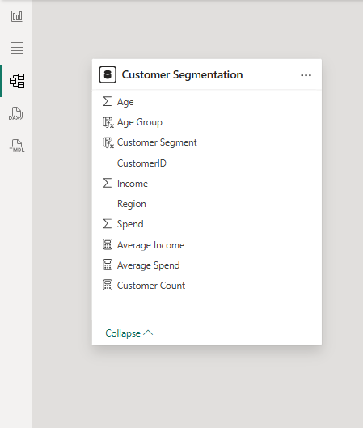
Data Preparation in Power BI
Data types were verified for each column.
Age groups were created to better categorize customers.
Spending behavior was analyzed using the Spend column.
Data was prepared to support customer segmentation analysis.

Slide 5
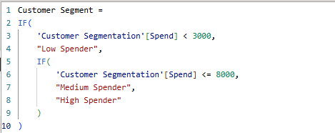
Customer Segmentation
Customers were grouped based on their spending levels using a DAX calculated column.
Segmentation Rules:
Spending Range | Segment
Spend < 3000 | Low Spender
Spend 3000 – 8000 | Medium Spender
Spend > 8000 | High Spender
This segmentation helps identify high-value customers and understand spending patterns across different customer groups

Slide 6
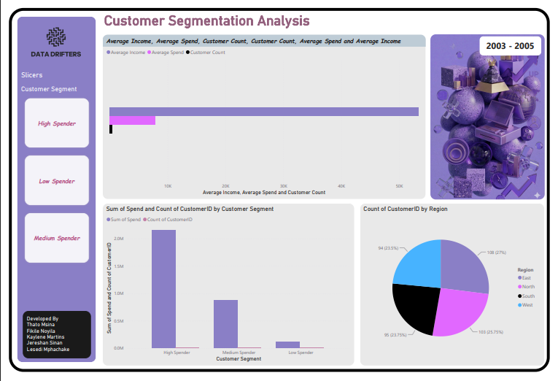
Key Dashboard Visuals
The Power BI dashboard includes the following visuals:
Spend by Segment (Column Chart) Shows the total spending contribution of each customer segment.
Customers by Region (Pie/Bar Chart) Displays how customers are distributed across regions.
Segment Slicer Allows users to filter the dashboard interactively by spending segment.

Slide 7
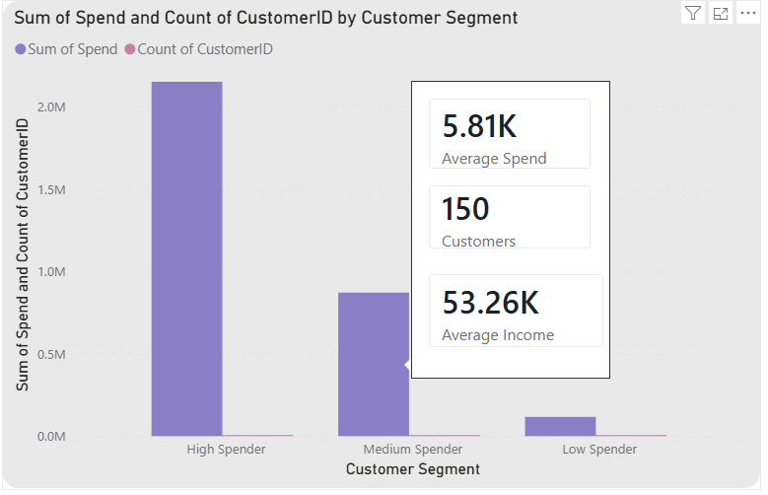
Insights from the Dashboard
High spenders contribute the largest portion of total revenue.
Medium spenders represent a large portion of the customer base.
Customer distribution varies across different regions, indicating potential market opportunities.
Interactive filters allow deeper analysis of specific customer groups.
These insights help businesses better understand customer behavior and target marketing strategies effectively.

Slide 8

Business Recommendations
Based on the analysis:
Focus marketing campaigns on high-value customers to increase loyalty.
Develop promotions to encourage medium spenders to spend more.
Target regions with higher customer concentration for marketing efforts.
Use data analytics regularly to monitor customer spending trends.
This approach can help the business increase revenue and improve customer engagement.

